Slide 1
Cosmic Ray Charge Reconstruction
Analysis of Direct Cherenkov Light Emission

Slide 2
Fitting and event reconstruction
  We need to determine x, y, height, Z and Epn
Five variables, but with constraints...
  Z is always an integer
  Non-hits for telescopes provide location information
  The energy must have been greater than the threshold for any chosen height.
  The images provide additional information, used to efficiently sample likely positions for reconstruction

Slide 3
Likelihood

Slide 4
Repeated Minimisation
Fix Z at integer value (Range Z=20-32)
Use a ~3x3m grid of points in 200m x 200m area
Select all points within reconstruction target (~10)
Iteratively minimise over 20 Epn and 3 Height starting values for each starting location
Run 13 x 10 x 20 x 3 = 7800 minimisations
Select minimisation candidate with lowest resultant log likelihood as overall minimum

Slide 5
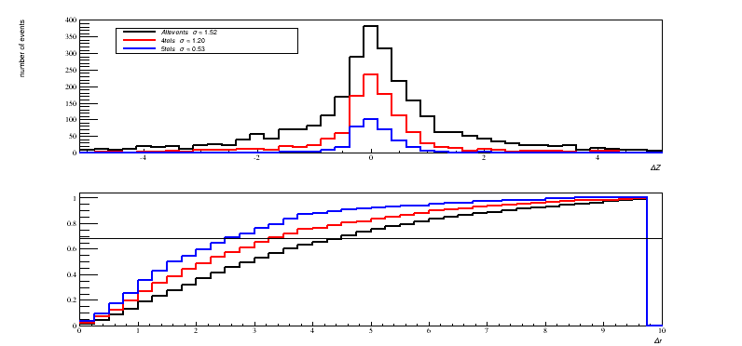

Slide 6
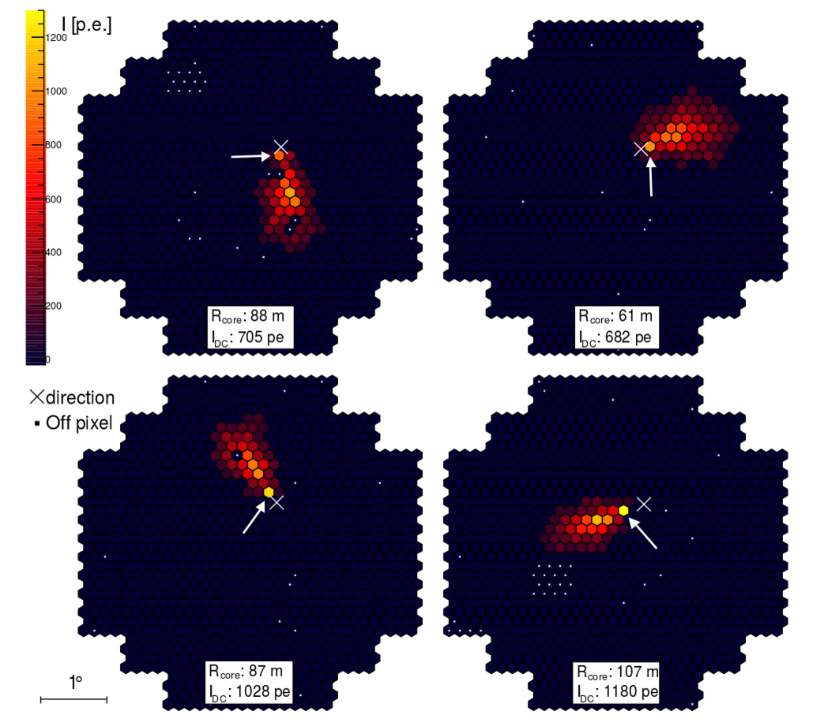

Slide 7
